Slide 1
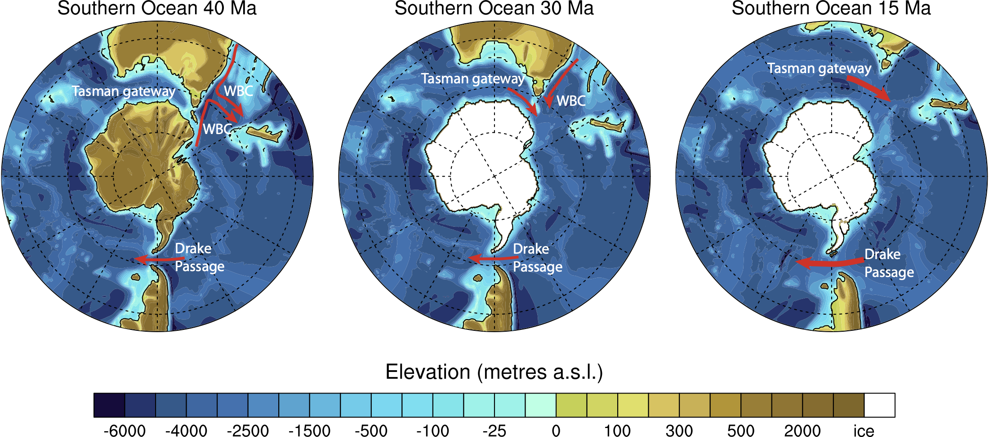

Did ocean circulation changes build the Antarctic ice sheet?
David Hutchinson
Climate Change Research Centre
UNSW Sydney

Slide 2

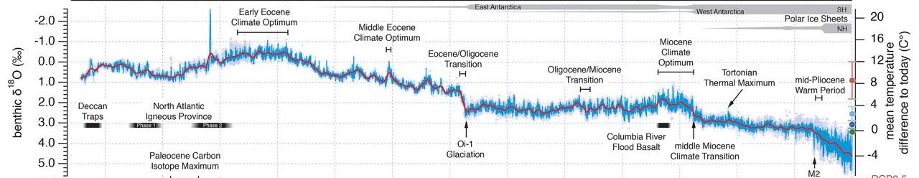


Climate from 66 million years to present
EOT
Westerhold et al, 2020
Eocene: Warm, ice-free world prior to 34 Ma
-> Deep ocean was 10-15 °C warmer than today
Oligocene: beginning of the Antarctic ice sheet
Decrease in CO₂ forcing
Major changes in ocean gateways and circulation

Slide 3
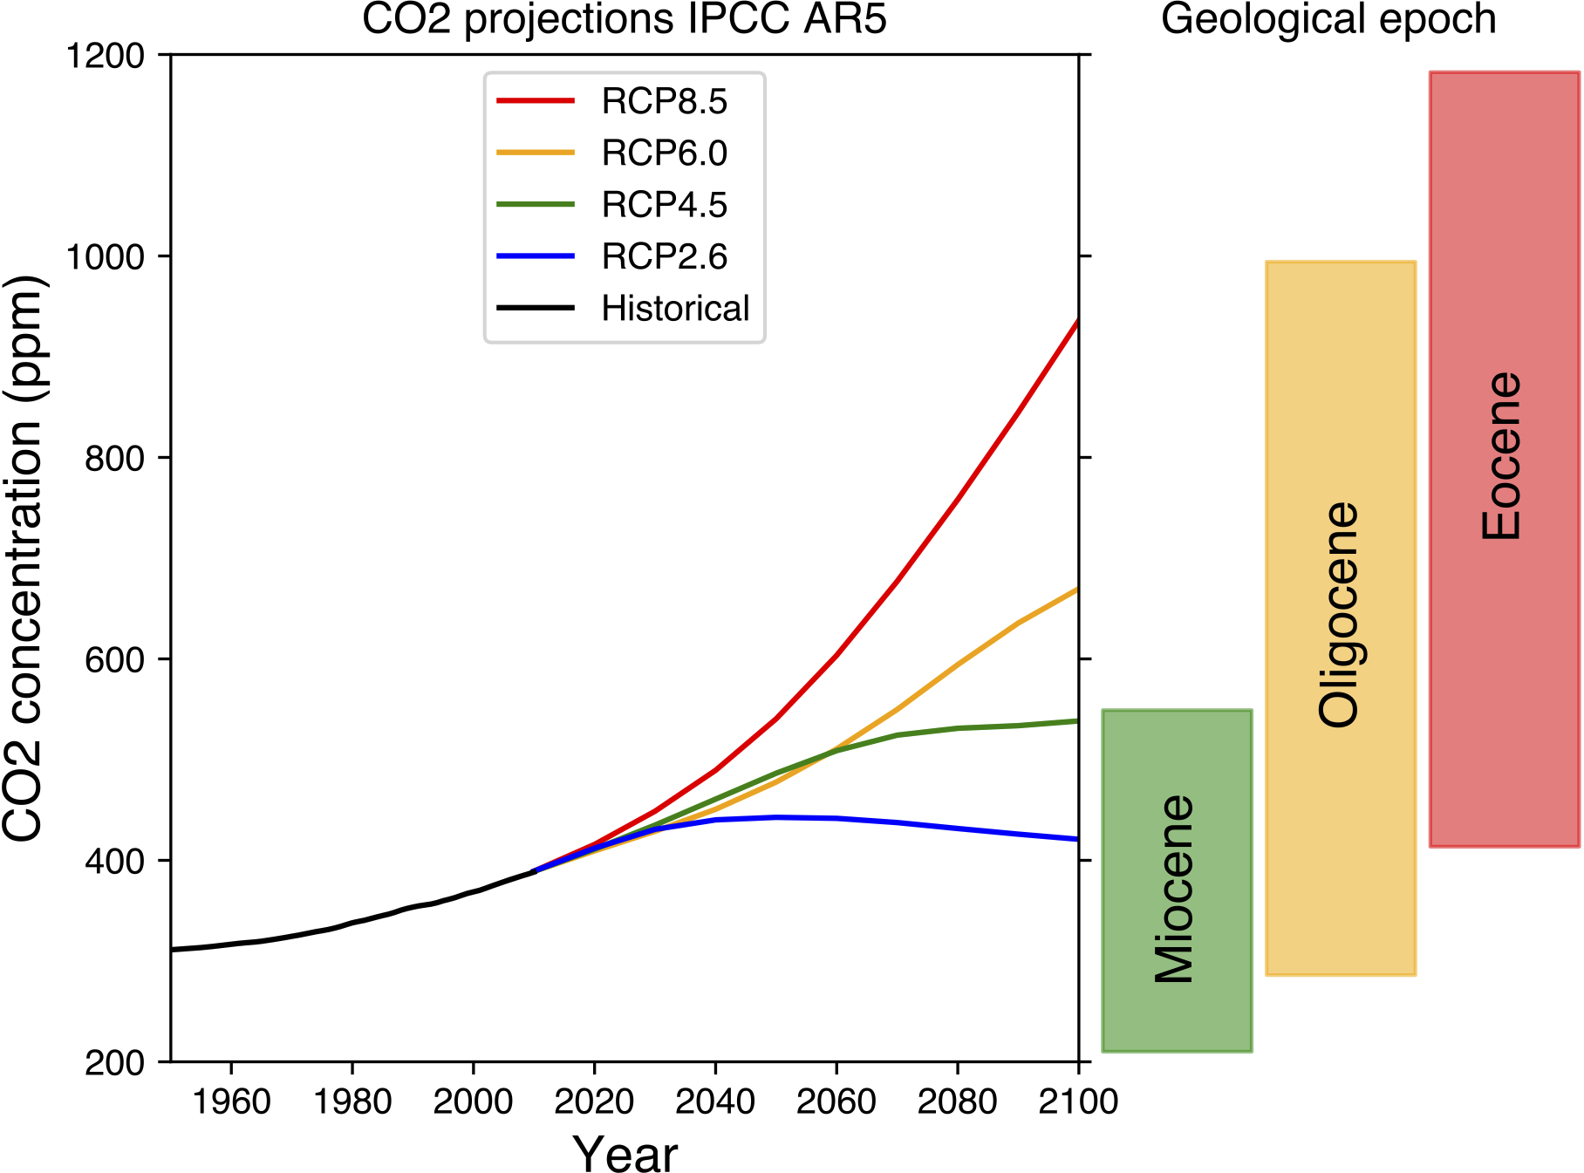
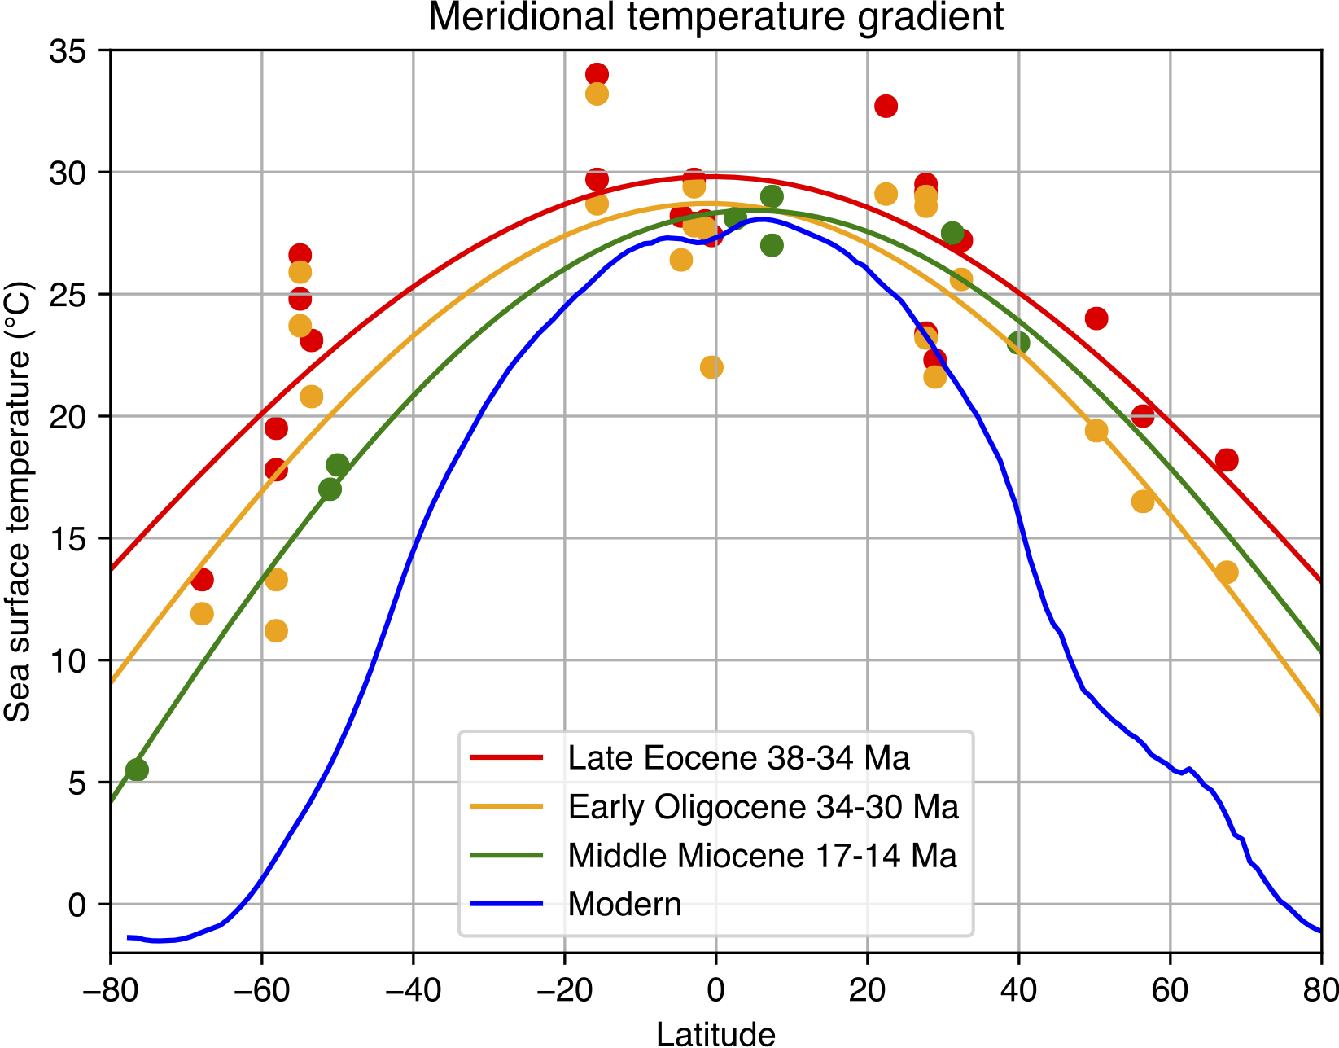
Why care about the Eocene-Oligocene?
5 23 34 56 Ma
High latitude climate much warmer than today (10-20°C)
But tropics only ~5°C warmer
Hard for climate models to capture this ‘low gradient’ world

Slide 4
Opening of gateways isolated Antarctica – caused cooling?

Slide 5
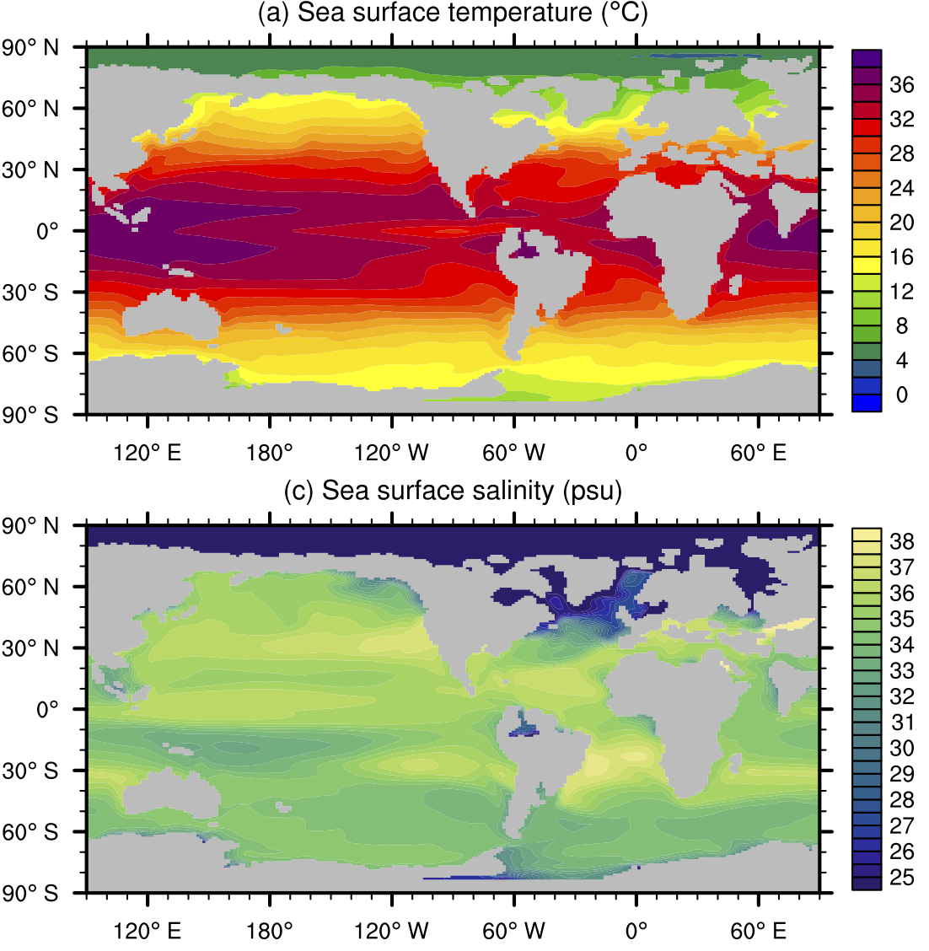
Climate model simulations: GFDL CM2.1
Control run: 800 ppm CO₂
6500 year simulation
SST equator ~35°C
Arctic 4-6°C
Southern Ocean 15-20°C
Arctic Ocean very fresh ~ 20 psu
North Atlantic: 25-30 psu -> much too fresh to sink
How might the salinity of the Atlantic increase to enable overturning?
Hutchinson et al, 2018, Clim. Past

Slide 6
Closure of the Arctic-Atlantic gateway
Paleogeographic evidence suggests Arctic-Atlantic gateway closed at the EOT
This closure causes N. Atlantic to become saltier than N. Pacific
N. Pacific overturning shuts down, N. Atlantic overturning starts up
Freshwater transport from Arctic may control Atlantic sinking
Hutchinson et al, 2019, Nature Communications

Slide 7
Future research: DECRA proposal
Extend GFDL simulations from Oligocene and Miocene
Use ACCESS-ESM1.5 to simulate Eocene, Oligocene and Miocene
Compare with CMIP6 projections
High-resolution Southern Ocean circulation
Constrain future climate change using past climate data + models

